Slide 1
Predictive Modeling
Chapter 4: Over-fitting and model tuning
STA 6543
The University of Texas at San Antonio

Slide 2
Outline
Overfitting and Model Tuning
Data Splitting
Resampling Methods
Cross Validation
Repeated Training/Test Splits
The Bootstrap
A Simple Classification Example

Slide 3
A motivating two-class data example
Consider the data having two predictors and containing 208 samples that can be either “Class 1”or “Class 2.”
There are 111 samples in Class 1 and 97 Class 2. Furthermore, there is a signiﬁcant overlap between the classes.
Goal: develop a predictive model to classify new samples. (This is just a simple classification problem)

Slide 4
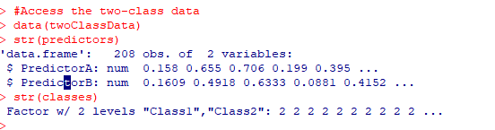
A motivating two-class data example
library(AppliedPredictiveModeling) library(caret) #Access the two-class data data(twoClassData) str(predictors) str(classes) data = cbind(predictors, classes) xyplot(PredictorA~PredictorB, group=classes, data=data, auto.key=list(column=2))

Slide 5
A motivating two-class data example
There is a signiﬁcant overlap between the classes.

Slide 6
Another way to draw scatter plot
library(AppliedPredictiveModeling) library(caret) #access the train function #Access the two-class data data(twoClassData) str(predictors) str(classes) #Use the regular plot function, instead of xyplot plot(predictors$PredictorA[classes=='Class1'], predictors$PredictorB[classes=='Class1'], xlab="Predictor A", ylab="Predictor B", xlim=c(0,0.7), ylim=c(0,0.7), col ='red', pch=2) points(predictors$PredictorA[classes=='Class2'], predictors$PredictorB[classes=='Class2'], pch=3, col ='green') legend('topleft', c("Class1", "Class 2"), col=c('red','green' ), pch=c(2,3))

Slide 7
A simple classification example

Slide 8
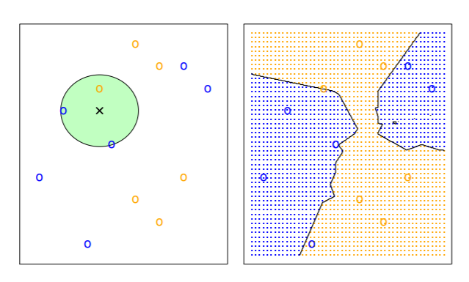
A predictive model: K-Nearest Neighbors (kNN) with k = 3
KNN is often used for Classification problems
You need to determine the value of the tuning parameter k.

Slide 9
kNN methods (codes available on the blackboard)

Slide 10
Comments on kNN methods
The previous panels show kNN with different values of k (i.e., k=1 and k = 100) and their associated class boundaries.
How do we determine an optimal value for k?
We may apply the KNN method available at the caret’s train package.

Slide 11
Apply kNN
#Apply kNN method available at the caret package set.seed(1) ctrl <- trainControl(method="repeatedcv",repeats = 3) knnFit <- train(classes ~ ., data = data, method = "knn", trControl = ctrl, preProcess = c("center","scale"), tuneLength = 25) knnFit plot(knnFit, print.thres = 0.5, type="S")

Slide 12
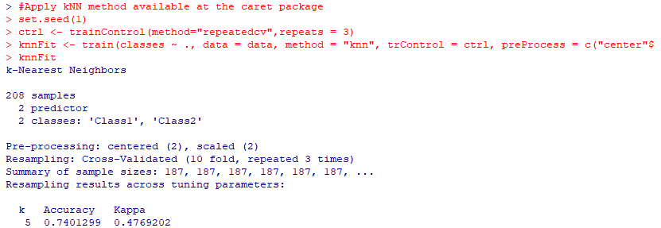
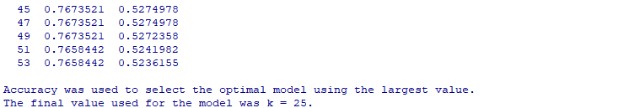
Apply kNN

Slide 13
kNN with k = 25
Which model is preferred? Why?

Slide 14

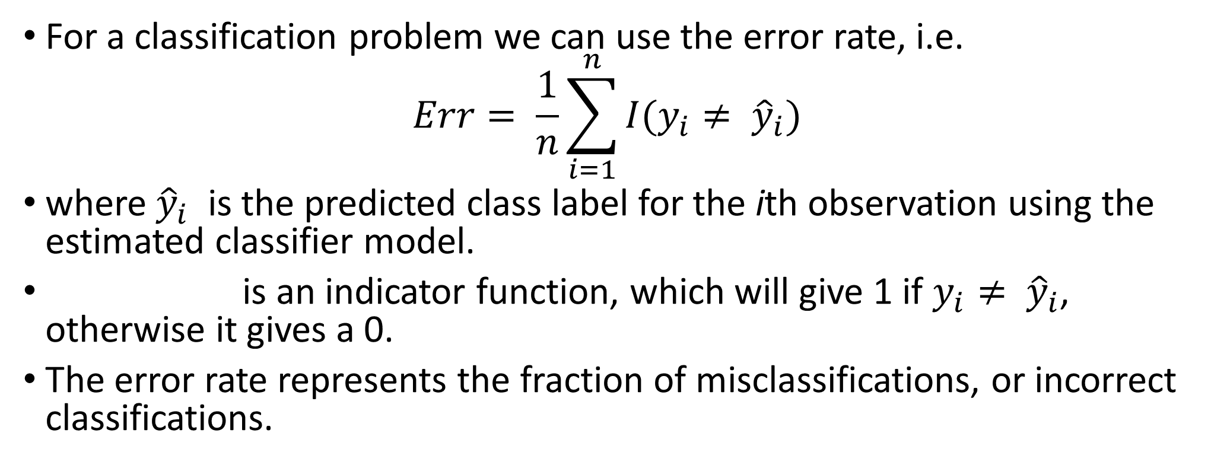
Measuring the quality of classifier
For a classification problem we can use the error rate, i.e.
$$Err= \frac{1}{n}\sum_{i=1}^{n}{I(y_{i}≠ {\hat{y}}_{i})}$$
where ${\hat{y}}_{i}$ is the predicted class label for the ith observation using the estimated classifier model.
is an indicator function, which will give 1 if $y_{i}≠ {\hat{y}}_{i}$, otherwise it gives a 0.
The error rate represents the fraction of misclassifications, or incorrect classifications.
$$I(y_{i}≠ {\hat{y}}_{i})$$

Slide 15
Training vs testing error rates
If we use the training data to estimate the error, which is referred as apparent performance of the model (i.e., the apparent error rate or the training error rate.)
If we use the testing data to estimate the error, which is referred as testing error of the model (i.e., the testing error rate.)
Questions:
(1) How to characterize how much a model is over-ﬁtting the training data?
(2) How to split the data as the training and testing data?

Slide 16
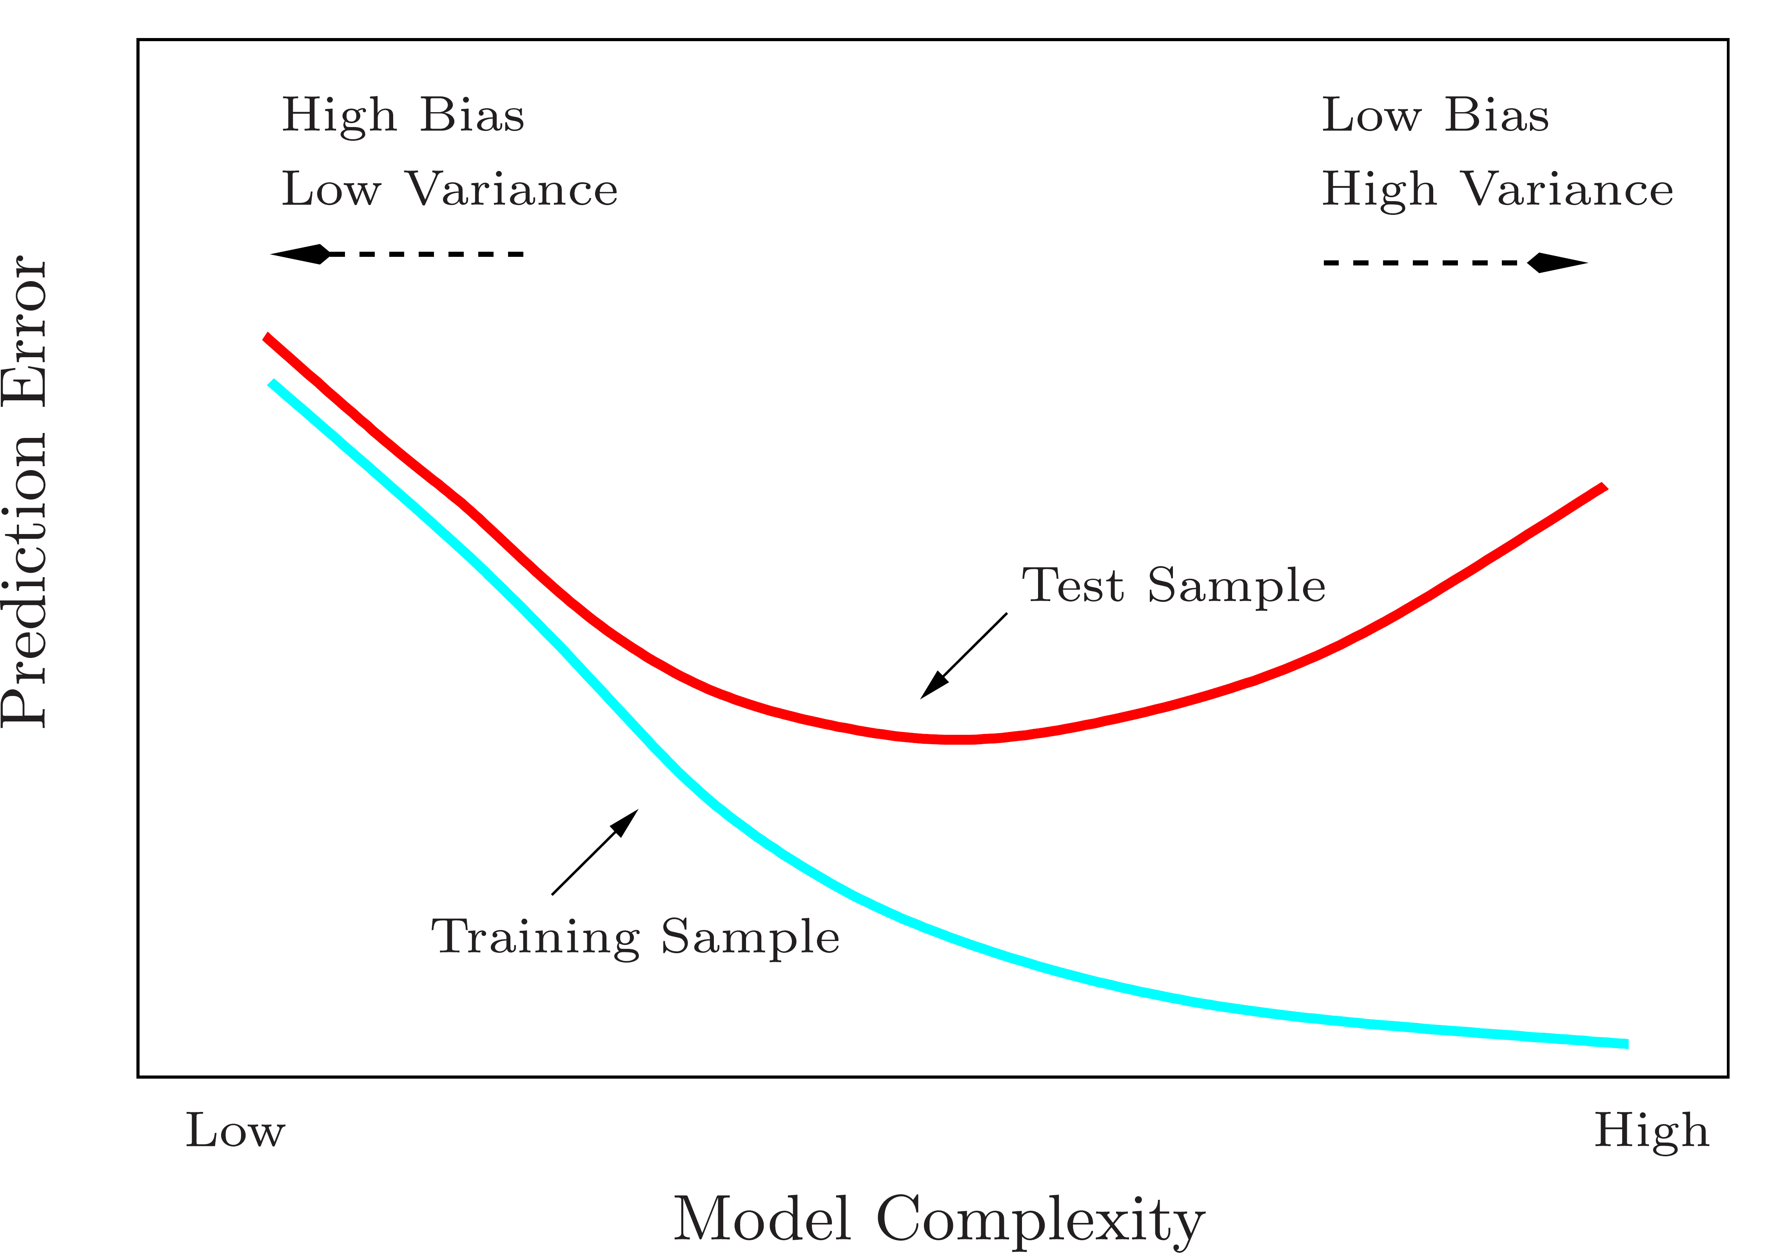
A fundamental picture
Training errors will always decline in general.
However, test errors will decline at first (as reductions in bias dominate) but will then start to increase again (as increases in variance dominate).
Test error rate is the key of choosing a learning method.

Slide 17
Model tuning
Many models have important model parameters which cannot be directly estimated from the data.
This type of parameter is referred to as a tuning parameter since there is no analytical formula available to calculate its appropriate value.
Poor choices for these tuning parameters could result in overfitting.
Different procedures can be used for searching for the best tuning parameters.
A schematic of the parameter tuning process is given below:

Slide 18
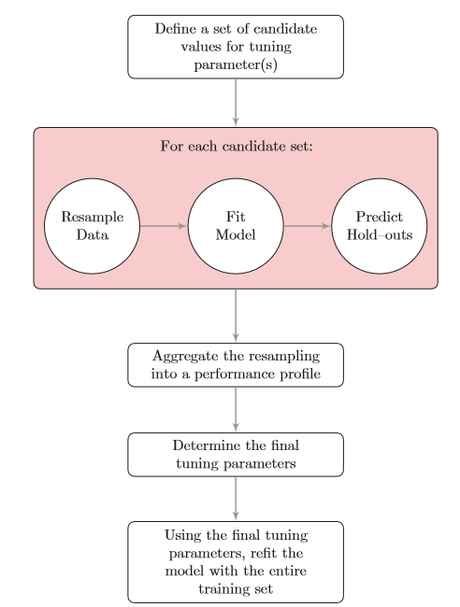

Slide 19
Data splitting
To find optimal tuning parameters, we often employ data splitting techniques.
A few of the common steps in model building are:
Pre-processing the predictor data
Estimating model parameters
Selecting predictors for the model
Evaluating model performance
Fine tuning class prediction rules (via ROC curves, etc.)
Some common ways for data splitting
Simple random splitting (homogeneous samples)
Stratified random splitting (keep structure within subgourps)
Maximum dissimilarity sampling (on the basis of the predictor values)

Slide 20
Data splitting in R
The base R function sample can create simple random splits of the data.
To create stratiﬁed random splits of the data (based on the classes), the createDataPartition function in the caret package can be used. (The percent of data that will be allocated to the training set should be speciﬁed)
For maximum dissimilarity sampling, the caret function maxdissim can be used to sequentially sample the data.

Slide 21
Resampling techniques
Idea: a subset of samples are used to ﬁt a model and the remaining samples are used to estimate the eﬃcacy of the model. This process is repeated multiple times and the results are aggregated and summarized.
k-fold cross-validation
Generalized cross-validation
Repeated training/test splits
The bootstrap

Slide 22
k-fold cross-validation
The choice of k is usually 5 or 10, but there is no formal rule.
As k gets larger, the diﬀerence in size between the training set and the resampling subsets gets smaller. As this diﬀerence decreases, the bias of the technique becomes smaller (i.e., the bias is smaller for k = 10 than k = 5).
From a practical viewpoint, larger values of k are more computationally burdensome.
When k is the number of samples, we have leave-one-out cross-validation (LOOCV).

Slide 23
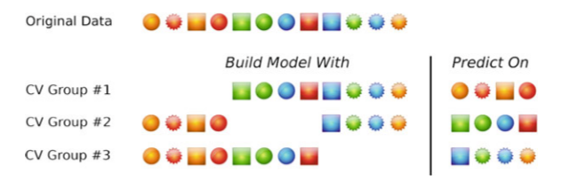
A schematic of threefold (k=3) cross-validation

Slide 24

Generalized cross-validation
For linear regression model, the generalized cross-validation (GCV) statistic is an approximation of the leave one-out error rate given by
where n is the sample size and df is the degrees of freedom of the model.

Slide 25
Repeated training/test splits
Leave-group-out cross validation or Monte Carlo cross-validation
It creates multiple splits of the data into modeling and prediction sets
A good rule of thumb for the proportion of data into the training data is about 75–80%. Higher proportions are a good idea if the number of repetitions is large.
A good rule of thumb for the number of repetitions is about 25. To get stable estimates of performance, it is suggested to choose a larger number of repetitions (say 50–200).

Slide 26
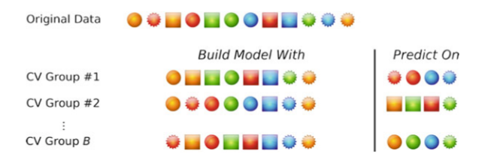
A schematic of B repeated training and test set partitions

Slide 27
The bootstrap
A bootstrap sample is a random sample of the data taken with replacement.
The bootstrap sample is the same size as the original data set.
Some samples will be represented multiple times in the bootstrap sample while others will not be selected at all. The samples not selected are usually referred to as the “out-of-bag” samples.
In general, bootstrap error rates tend to have less uncertainty than k-fold cross-validation.

Slide 28
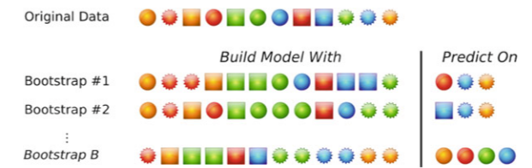
A schematic of bootstrap resampling

Slide 29
A simple classification example
library(AppliedPredictiveModeling) data(twoClassData) str(predictors) str(classes) ## Split the data into training (80%) and test sets (20%) set.seed(100) x = cbind(predictors, classes) inTrain <- createDataPartition(classes, p = .8)[[1]] ClassTrain <- x[inTrain, ] ClassTest <- x[-inTrain, ]

Slide 30
A simple classification example
#Hyperparameter Estimation For The Gaussian Radial Basis Kernel library(kernlab) set.seed(231) #frac: fraction of data to use for estimation. #By default a quarter of the data is used to estimate #the range of the sigma hyperparameter. sigDist <- sigest(classes~ ., data = ClassTrain, frac = 1) sigDist svmTuneGrid <- data.frame(sigma = as.vector(sigDist)[1], C = 2^(-2:7)) svmTuneGrid

Slide 31
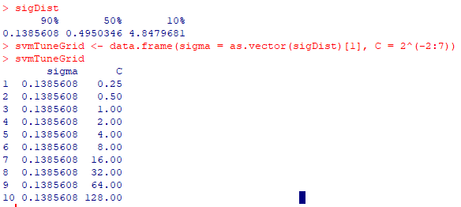
sigest for SVM with Gaussian radial basis kernel
https://www.rdocumentation.org/packages/kernlab/versions/0.9-29/topics/sigest

Slide 32
SVM with svmTuneGrid
set.seed(1056) svmFit <- train(classes~ ., data = ClassTrain, method = "svmRadial", preProc = c("center", "scale"), tuneGrid = svmTuneGrid, trControl = trainControl(method = "repeatedcv", repeats = 5, classProbs = TRUE)) ## classProbs = TRUE was added since the text was written ## Print the results svmFit

Slide 33
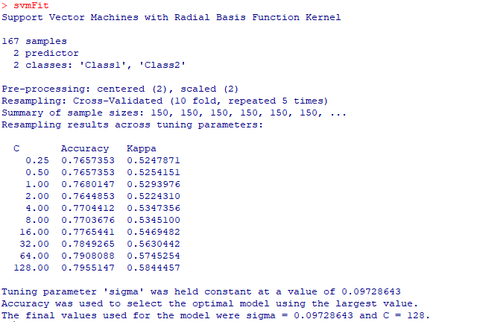

Slide 34
SVM with svmTuneGrid
## A line plot of the average performance. ## The 'scales' argument is actually an argument ## to xyplot that converts the x-axis to log-2 units. plot(svmFit, scales = list(x = list(log = 2))) ## Test set predictions predictedClasses <- predict(svmFit, ClassTest) str(predictedClasses) ## Use the "type" option to get class probabilities predictedProbs <- predict(svmFit, newdata = ClassTest, type = "prob") head(predictedProbs)

Slide 36
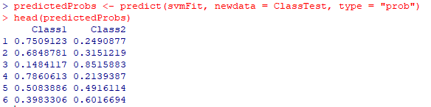


Slide 37
Fit the same model using different resampling methods.
#10-fold cross validation set.seed(1056) svmFit10CV <- train(classes ~ ., data = ClassTrain, method = "svmRadial", preProc = c("center", "scale"), tuneGrid = svmTuneGrid, trControl = trainControl(method = "cv", number = 10)) svmFit10CV

Slide 38
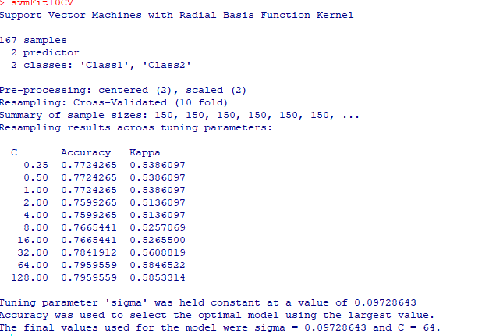

Slide 39
Fit the same model using different resampling methods.
#LOOCV set.seed(1056) svmFitLOO <- train(classes ~ ., data = ClassTrain, method = "svmRadial", preProc = c("center", "scale"), tuneGrid = svmTuneGrid, trControl = trainControl(method = "LOOCV")) svmFitLOO

Slide 40
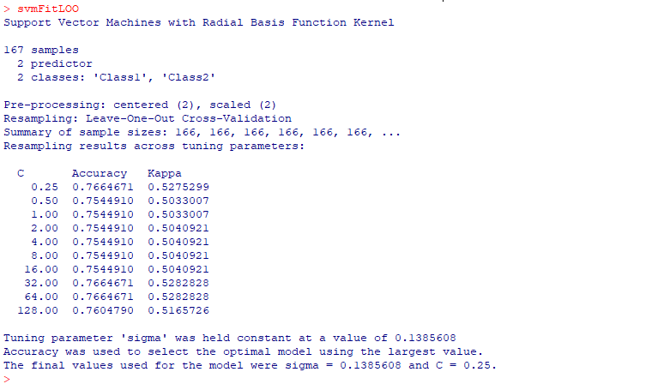

Slide 41
Fit the same model using different resampling methods.
#Repeated Training/leave-group-out cross validation set.seed(1056) svmFitLGO <- train(classes ~ ., data = ClassTrain, method = "svmRadial", preProc = c("center", "scale"), tuneGrid = svmTuneGrid, trControl = trainControl(method = "LGOCV", number = 50, p = .8)) svmFitLGO

Slide 42
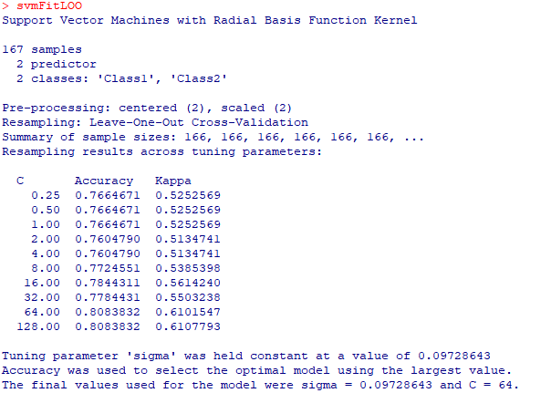

Slide 43
Fit the same model using different resampling methods.
#The bootstrap set.seed(1056) svmFitBoot <- train(classes ~ ., data = ClassTrain, method = "svmRadial", preProc = c("center", "scale"), tuneGrid = svmTuneGrid, trControl = trainControl(method = "boot", number = 50)) svmFitBoot

Slide 44
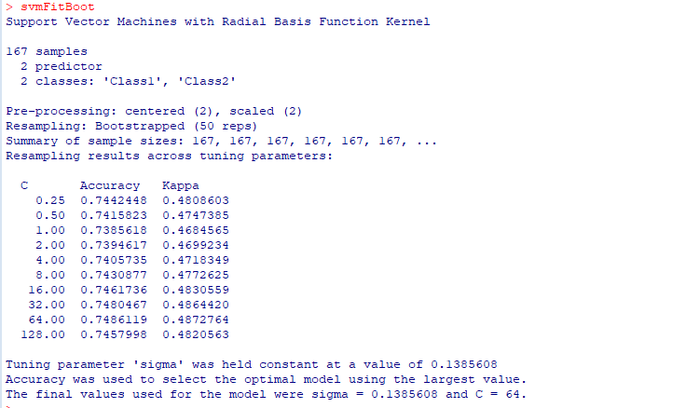

Slide 45
Fit the same model using different resampling methods.
#The bootstrap632 set.seed(1056) svmFitBoot632 <- train(classes ~ ., data = ClassTrain, method = "svmRadial", preProc = c("center", "scale"), tuneGrid = svmTuneGrid, trControl = trainControl(method = "boot632", number = 50)) svmFitBoot632

Slide 46
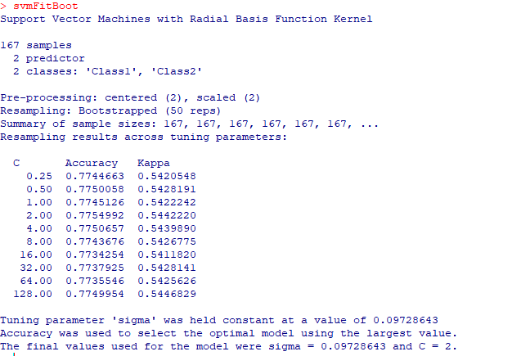

Slide 47
Between model comparisons
As an illustration, we contrast the SVM model with a logistic regression model.
We can compare the models with respect to the values of Accuracy and Kappa.
One sample-t test or ANOVA test with Bonferroni correction can be conducted for the differences of accuracy and/or Kappa
We then make a decision based on the resulting p-values from a statistical test.

Slide 48
set.seed(1056) svmFit <- train(classes~ ., data = ClassTrain, method = "svmRadial", preProc = c("center", "scale"), tuneGrid = svmTuneGrid, trControl = trainControl(method = "repeatedcv", repeats = 5, classProbs = TRUE)) svmFit set.seed(1056) glmProfile <- train(classes ~ ., data = ClassTrain, method = "glm", trControl = trainControl(method = "repeatedcv", repeats = 5)) glmProfile

Slide 49
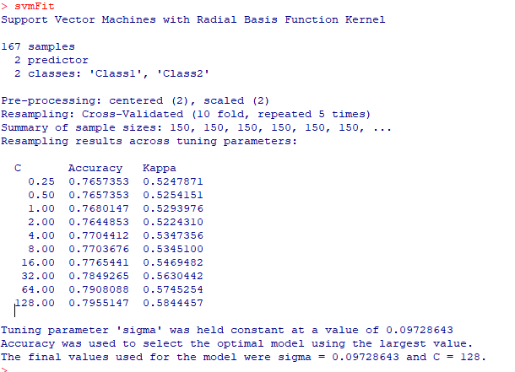
svmFit

Slide 50
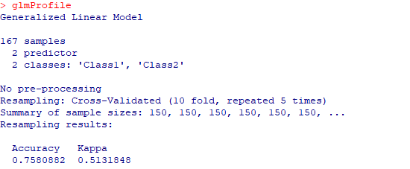
glmProfile

Slide 51
Between model comparisons
resamp <- resamples(list(SVM = svmFit, Logistic = glmProfile)) summary(resamp) modelDifferences <- diff(resamp) summary(modelDifferences) ## The actual paired t-test: modelDifferences$statistics$Accuracy

Slide 52
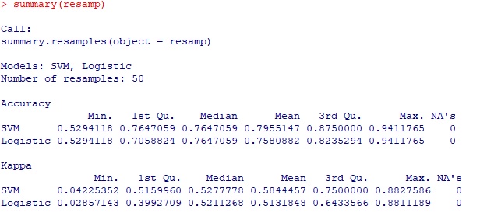
The results of resamples

Slide 53
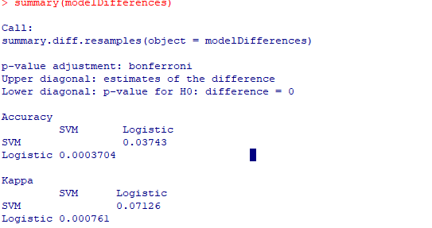
Summary of model differences

Slide 54
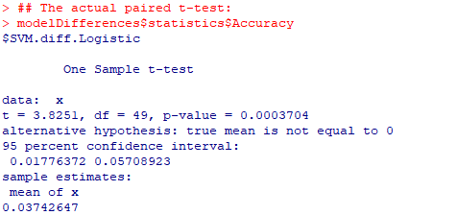
One Sample t-test for model comparison
What conclusion can be drawn from the p-value of 0.0003704?

